Slide 1
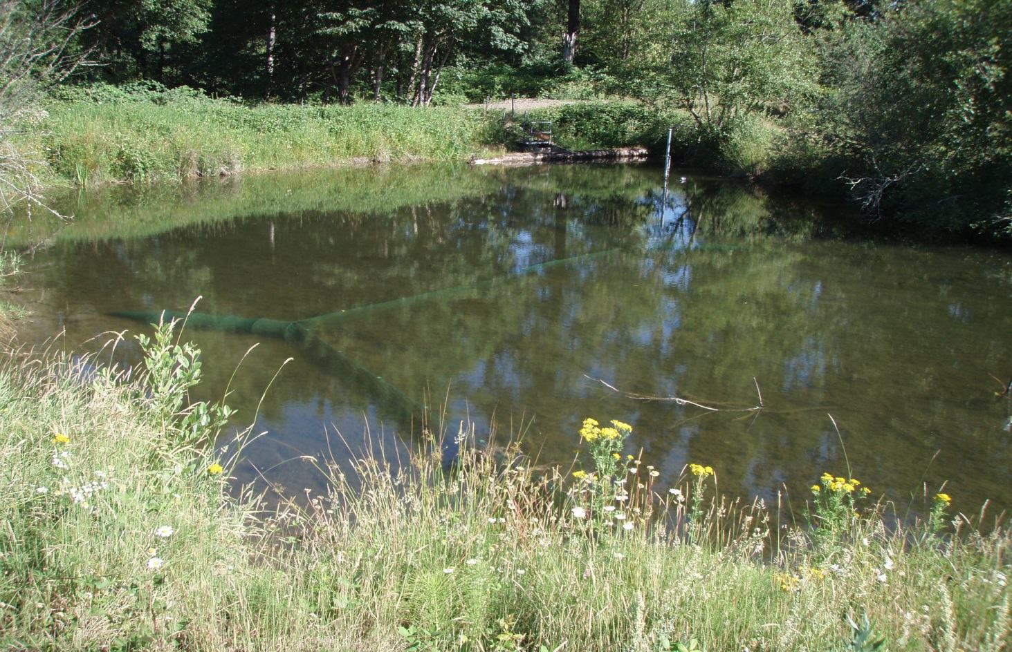
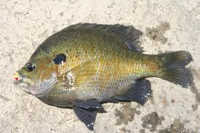
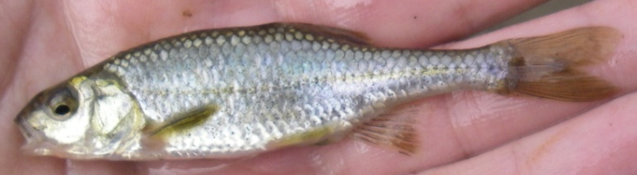

Do Native and Nonnative Fish Partition Floodplain Habitats?
Paul Scheerer, Brian Bangs, and Shaun Clements
Native Fish Investigations Program
Oregon Department of Fish and Wildlife

Slide 2
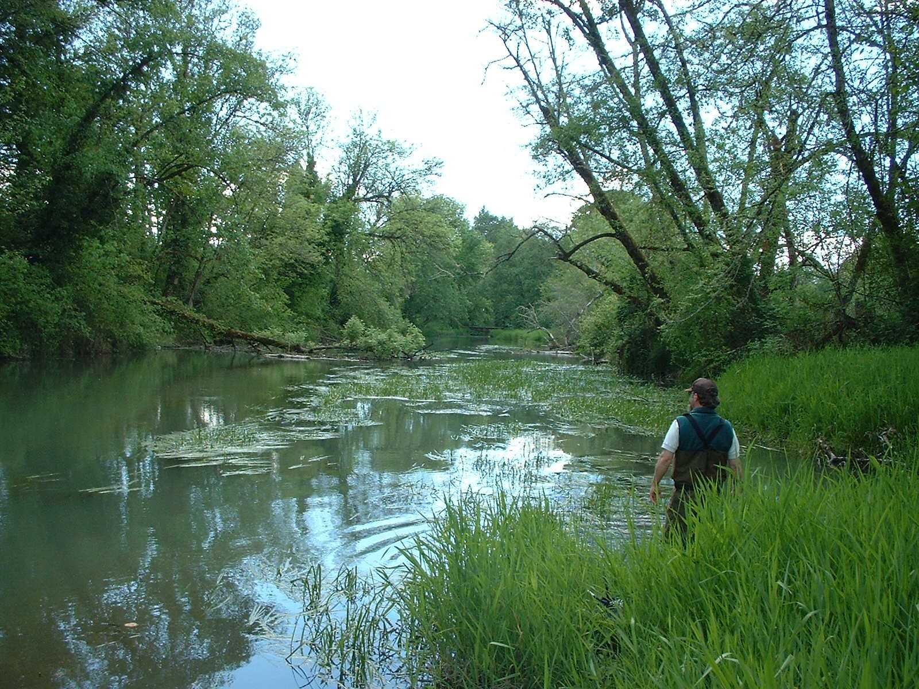
Native & Nonnative Fishes in Floodplain Habitats
Lots of native and nonnative fish coexist in Willamette floodplain habitats
  Bluegill- most common and abundant nonnative
  What conditions allow this to occur?
    Temperature, depth, aquatic vegetative cover, connectivity

Slide 3
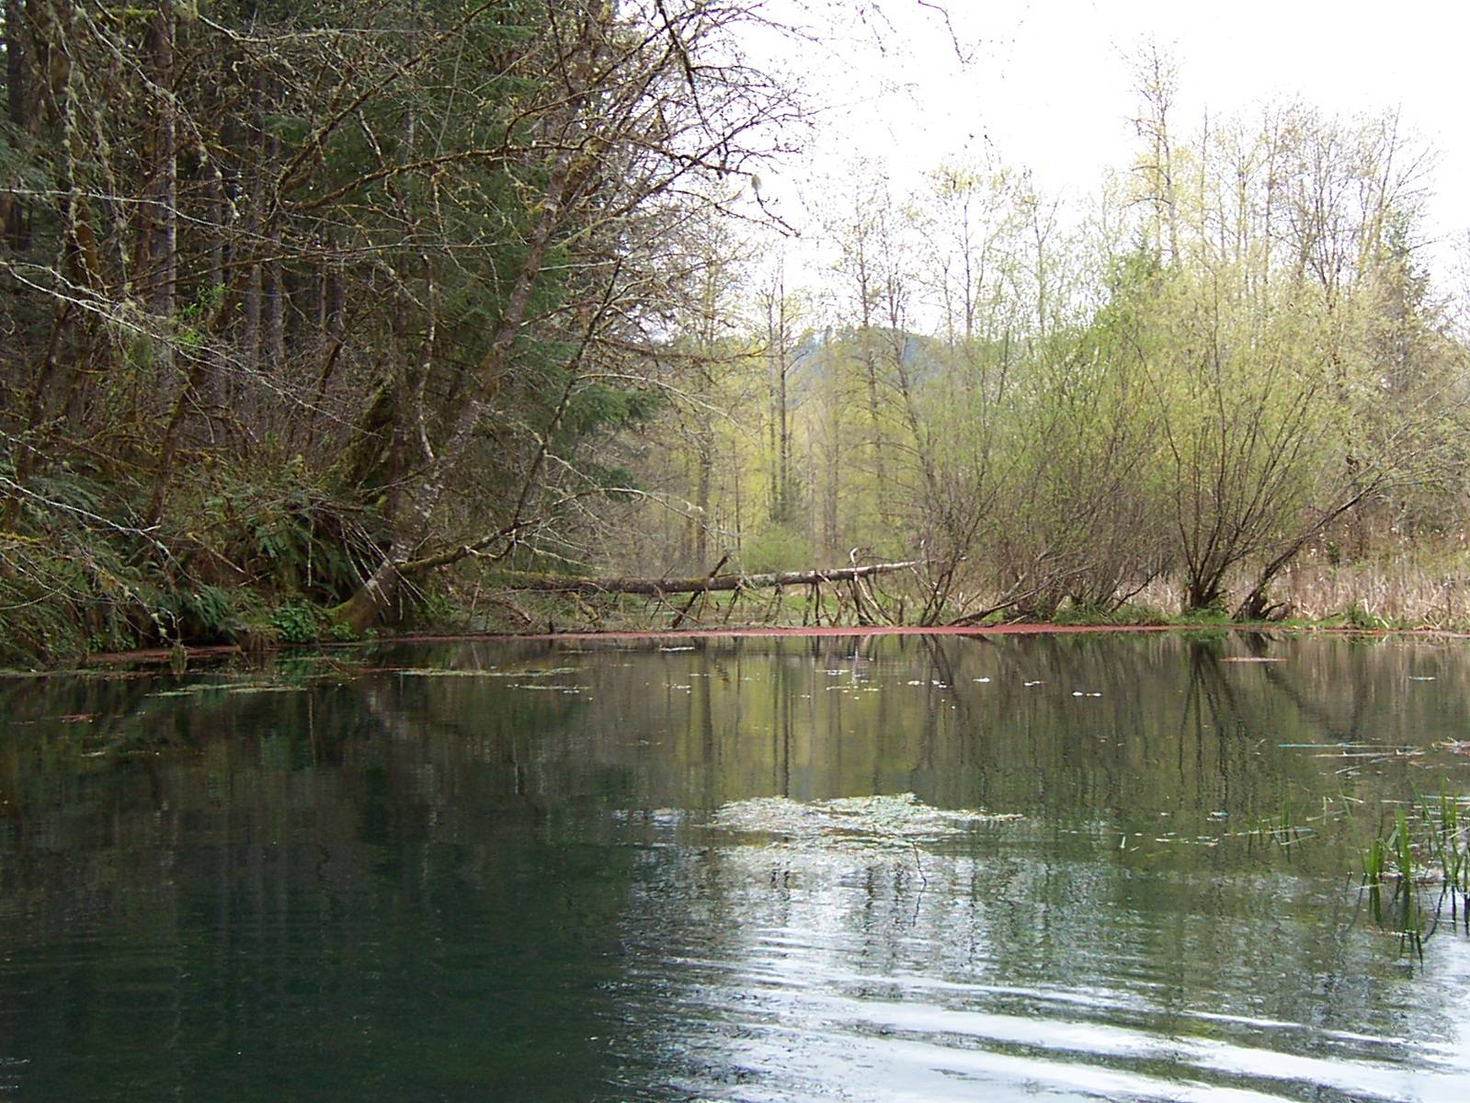
Pilot Study Objective
Describe bluegill habitat use in an off-channel, slough-like habitat containing Oregon chub

Slide 4
Study Site
Geren Island (North Santiam)
Slough-like channel >400 x 7 m
“Closed”
Range of temperatures, depths, and aquatic vegetative cover
Bluegill and Oregon chub abundant
Other fish species in low abundance

Slide 5
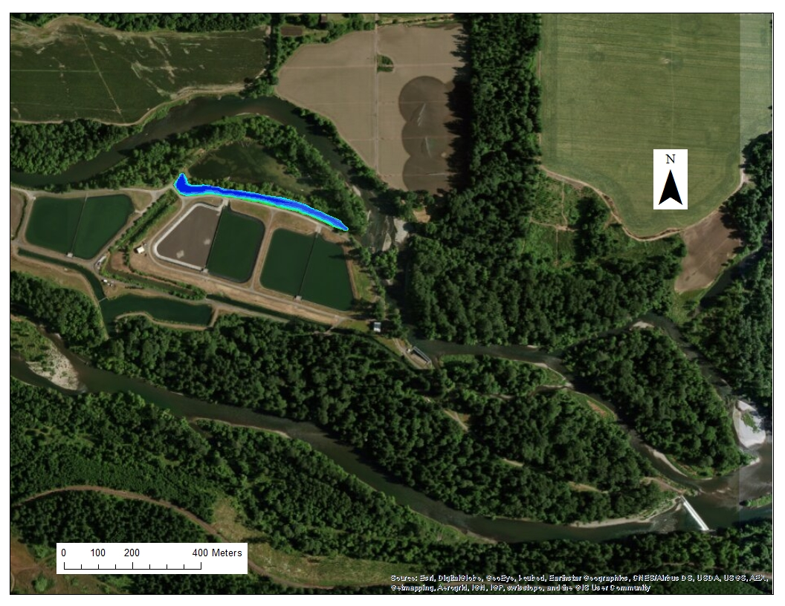
Study Site
Geren Island
Upper Bennett Dam

Slide 6
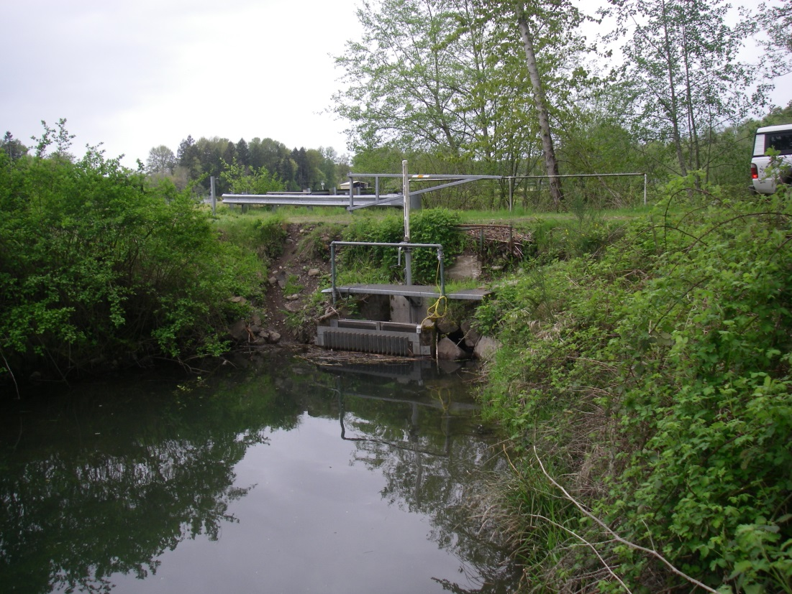
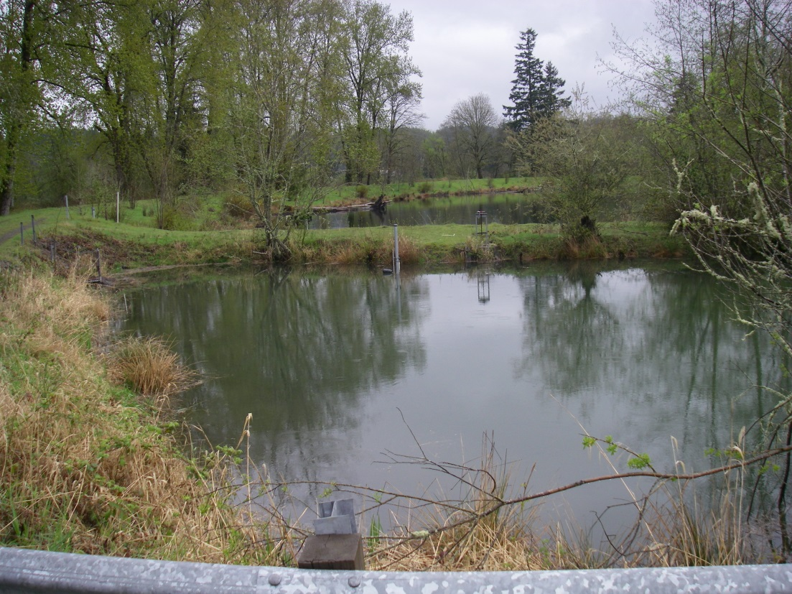
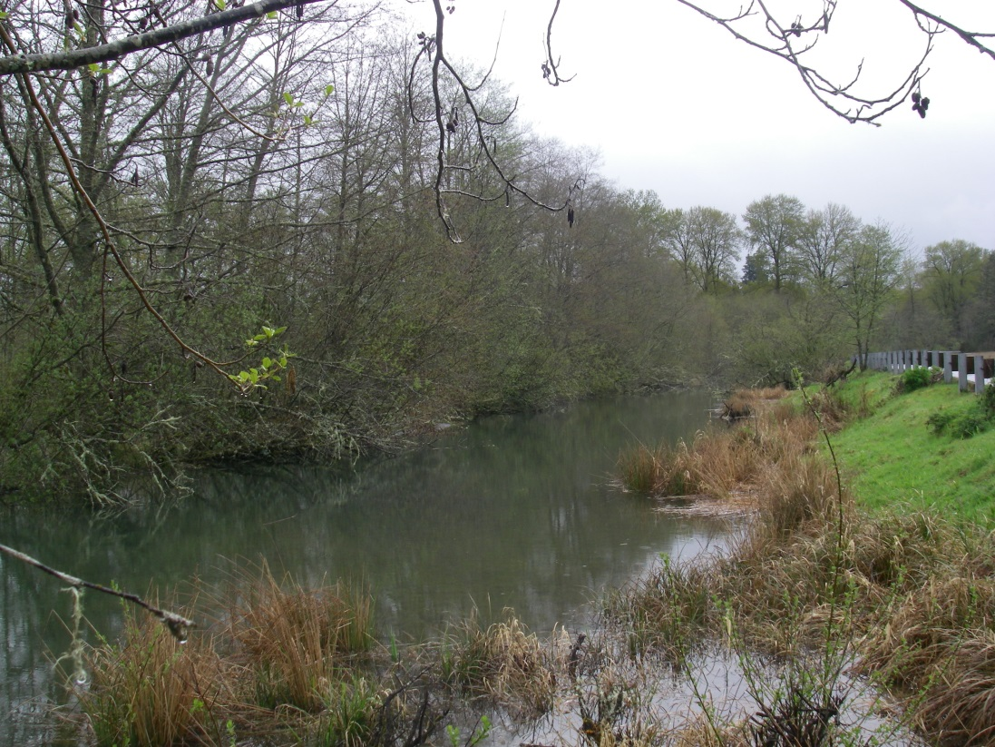
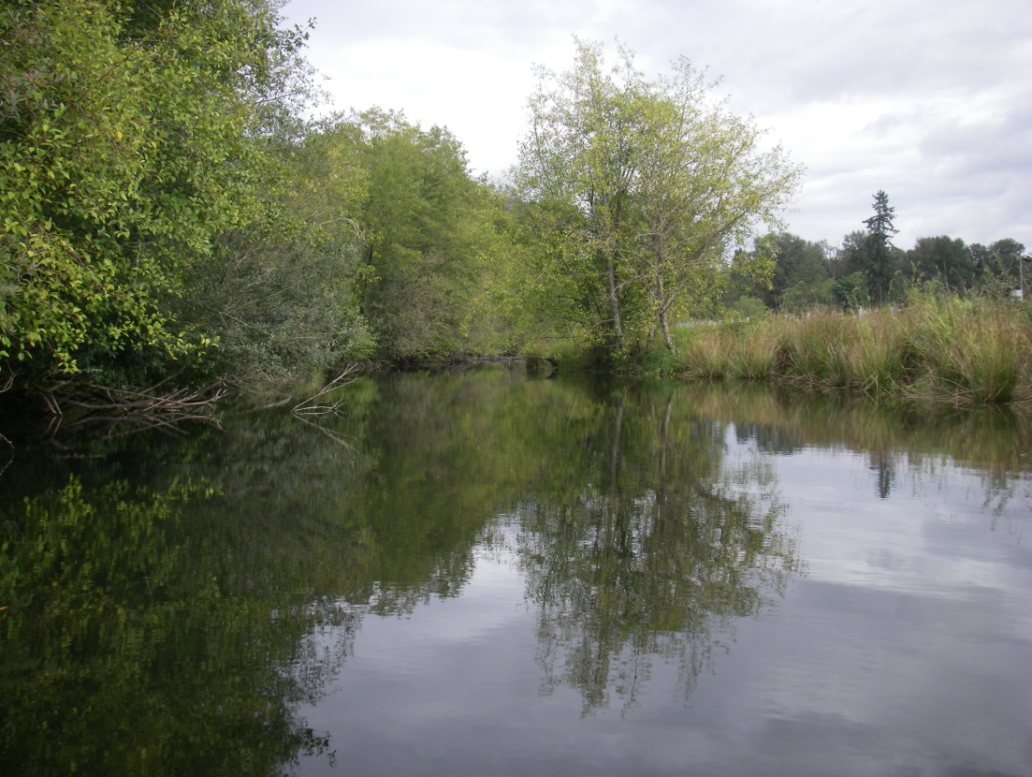
Study Site

Slide 7
Study Design
Compare bluegill habitat use versus availability
  Divide slough into habitat units based on depth, vegetative cover, temperature, edge vs. offshore

Slide 8

Study Methods
Installed PIT antennas at each habitat unit (20 units, 2-3 replicate units)
PIT-tagged 523 bluegills (57-153 mm TL)
Described habitat at each unit and throughout the study area
Trapped and VIE marked Oregon chub
7 July through 1 October (12 weeks)

Slide 9
Analysis
Are there habitats that bluegill are not using?
Compare bluegill and Oregon chub habitat usage
Develop model to determine which variables explain bluegill habitat use

Slide 10
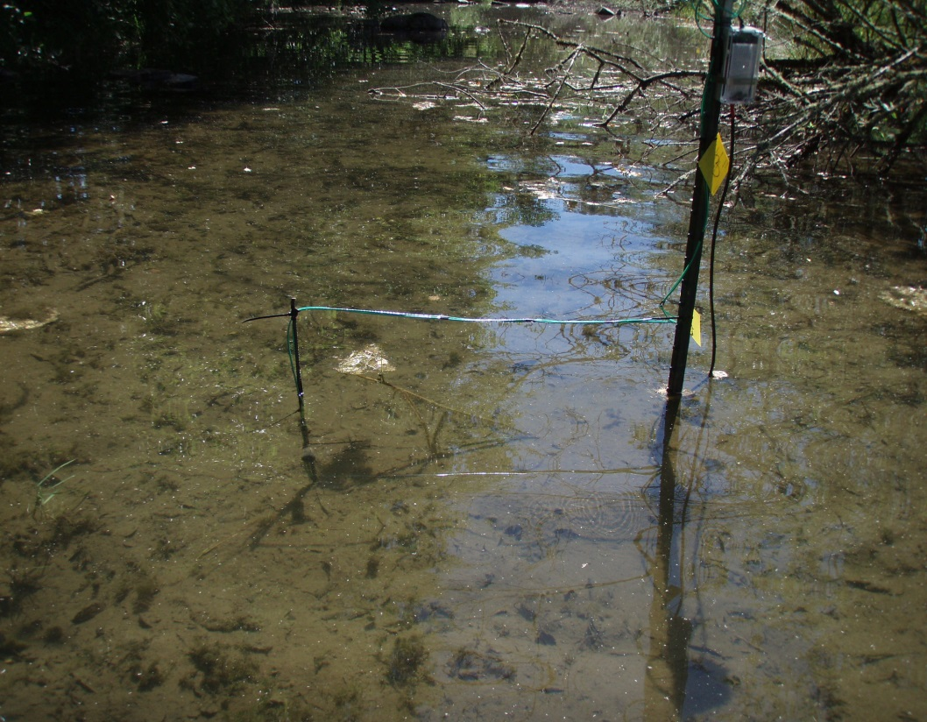
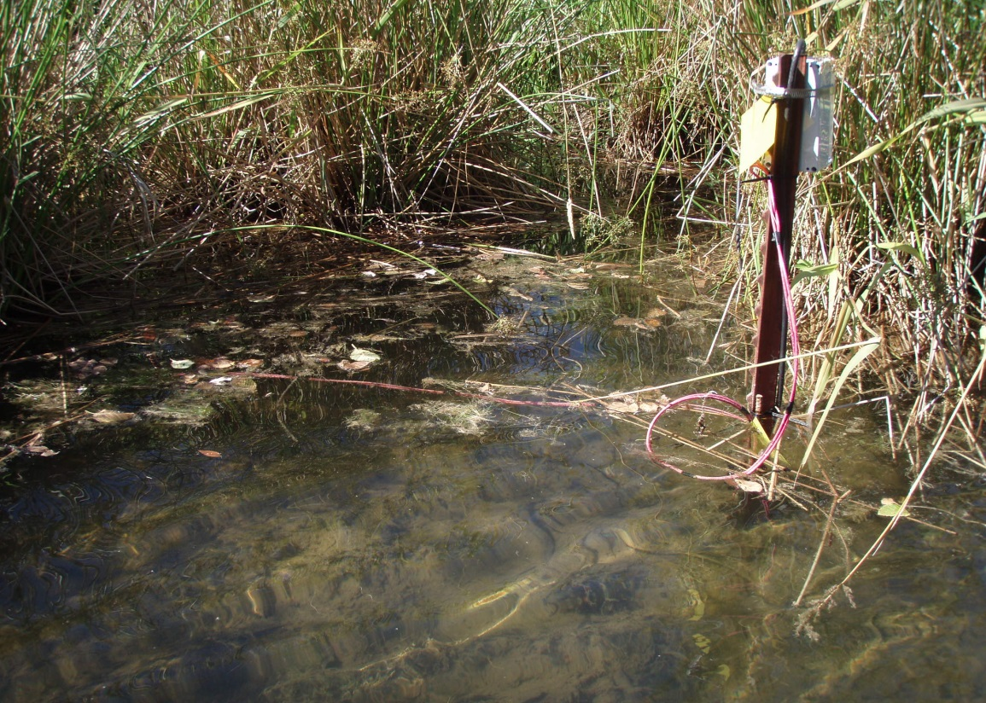
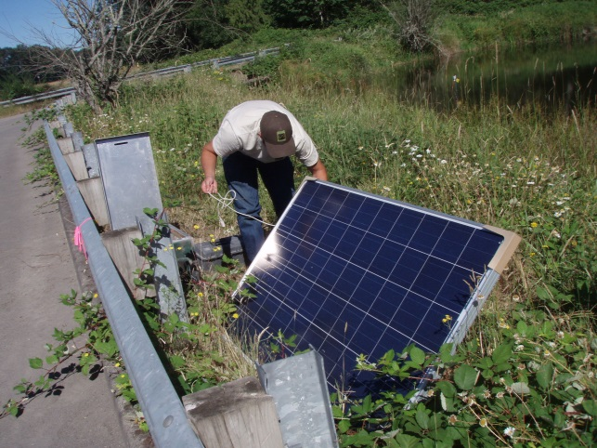
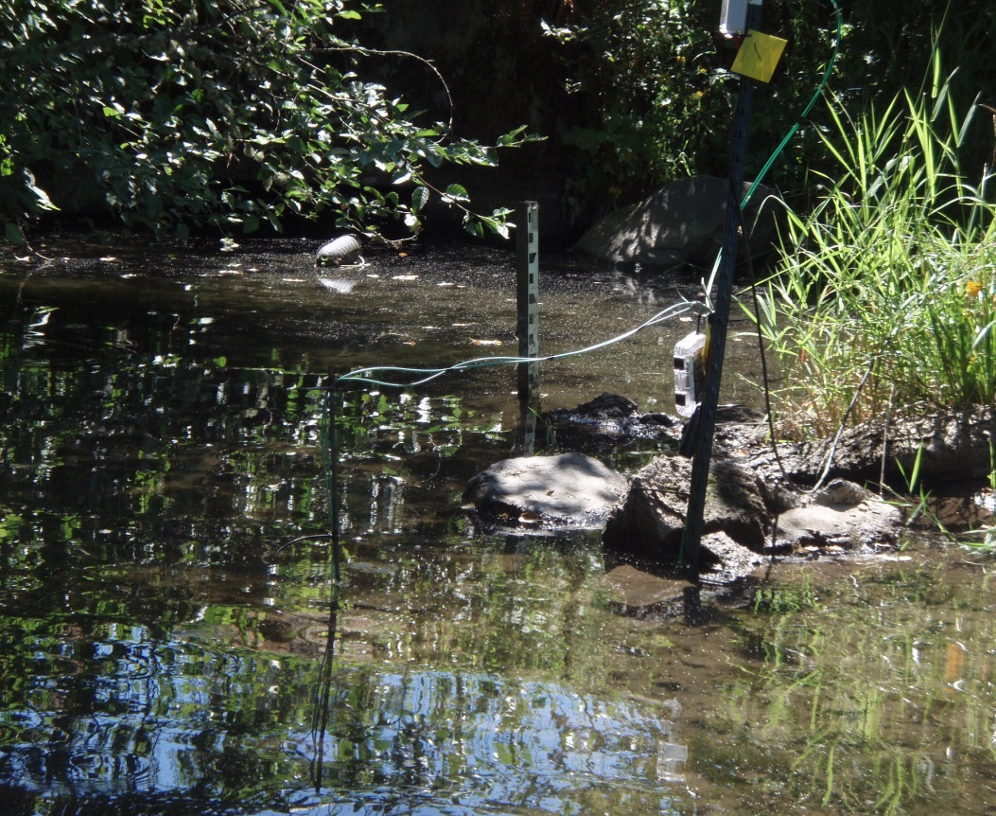
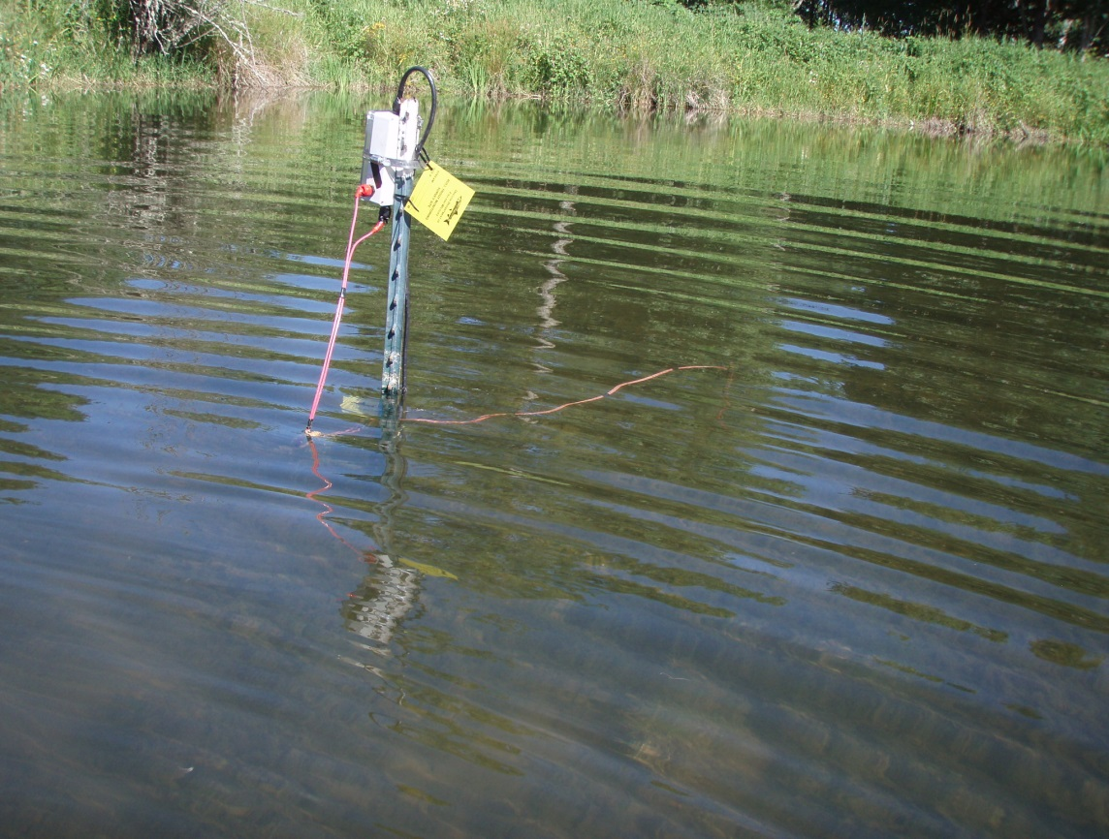

Slide 11
Data Compilation / Format
Bluegills detections: unique fish per ½ hour, by antenna (~14,000 detections)
Linked water temperatures and water depths
Mapped and calculated available habitat (depth, temperature, and vegetation)

Slide 12
Mapping

Slide 13
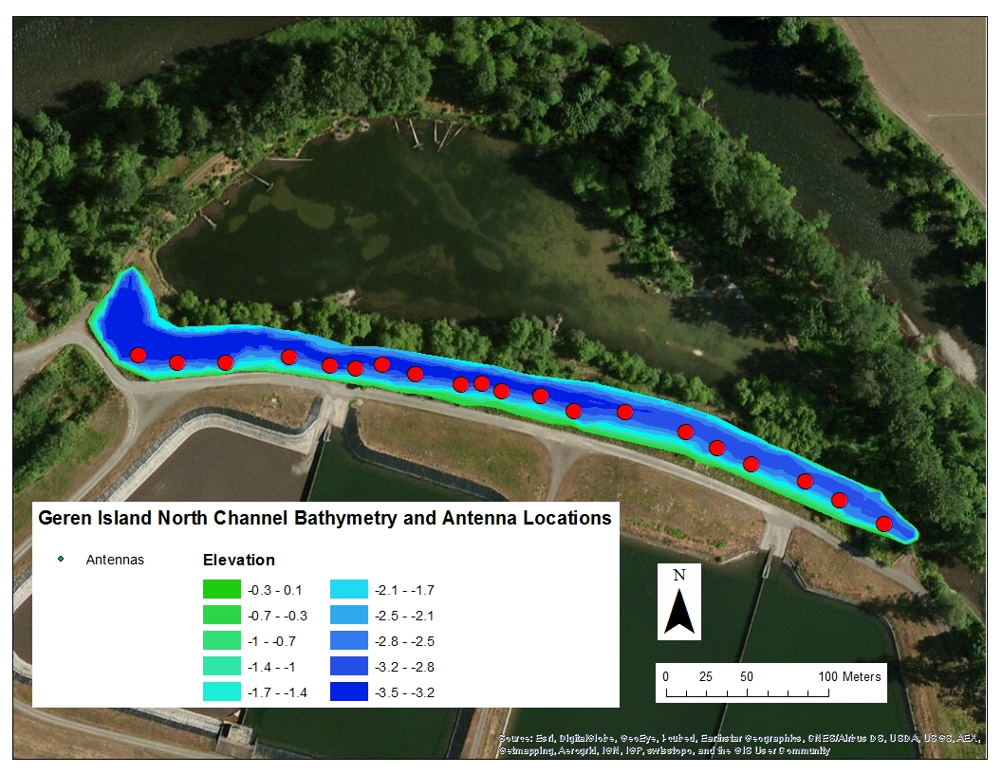
Bathymetry
flow

Slide 14
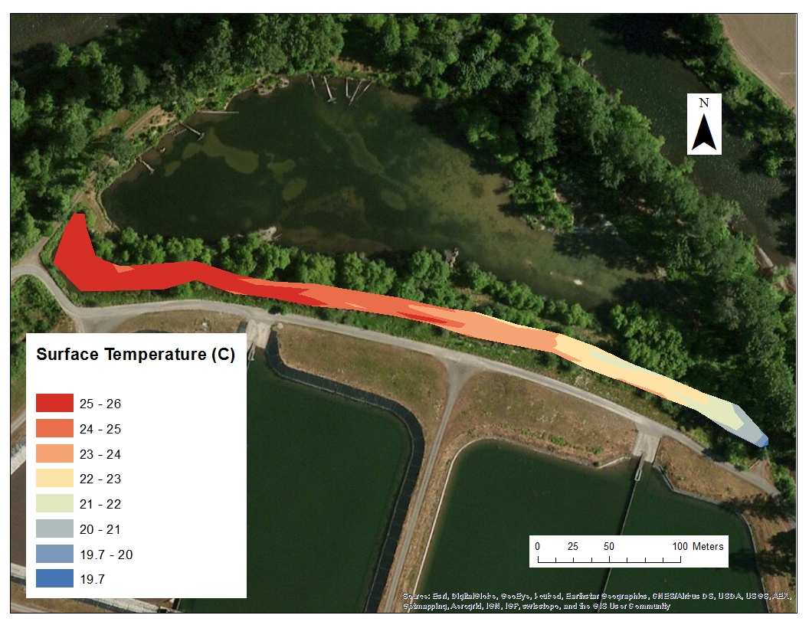
Temperatures
flow
August 18, 2014

Slide 15
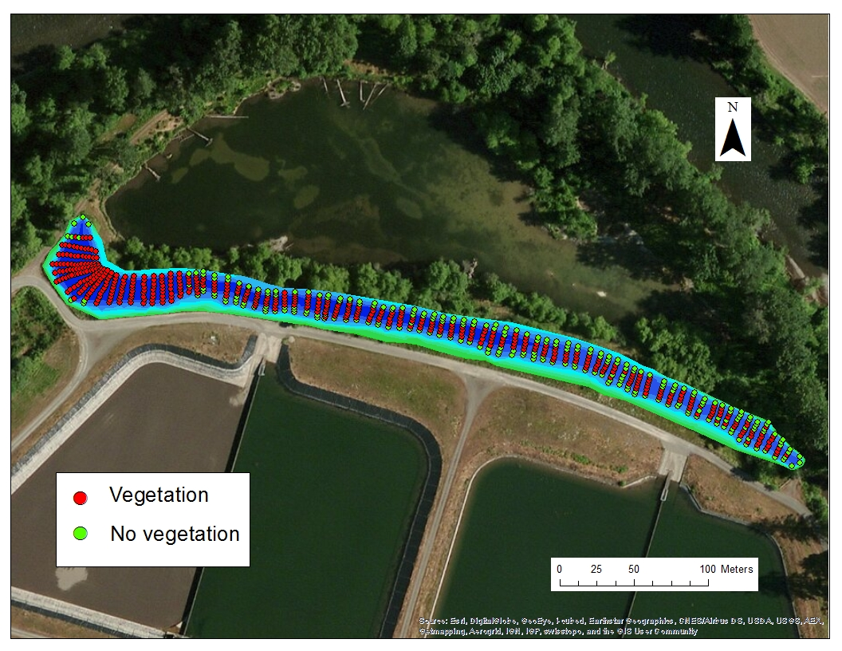
Aquatic Vegetation

Slide 16
Temperatures

Slide 17
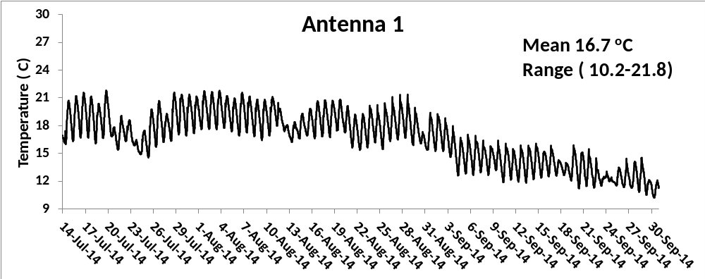
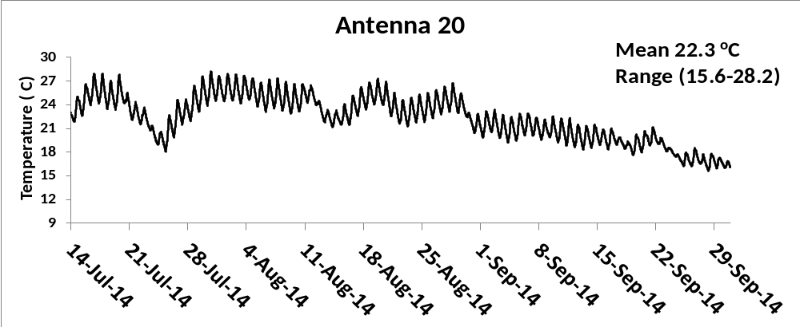
Water Temperatures
Temperatures changed systematically during study

Slide 18
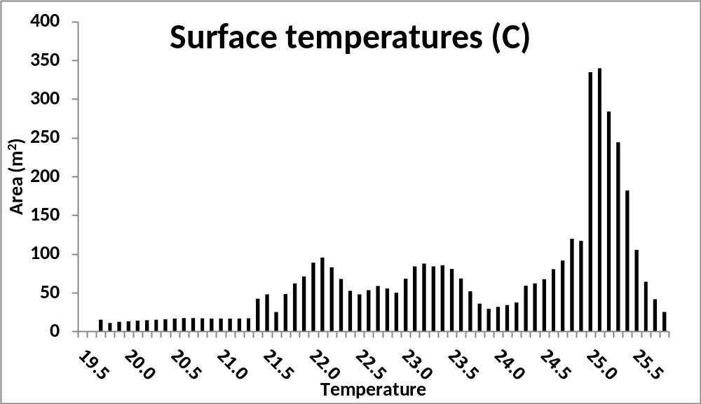
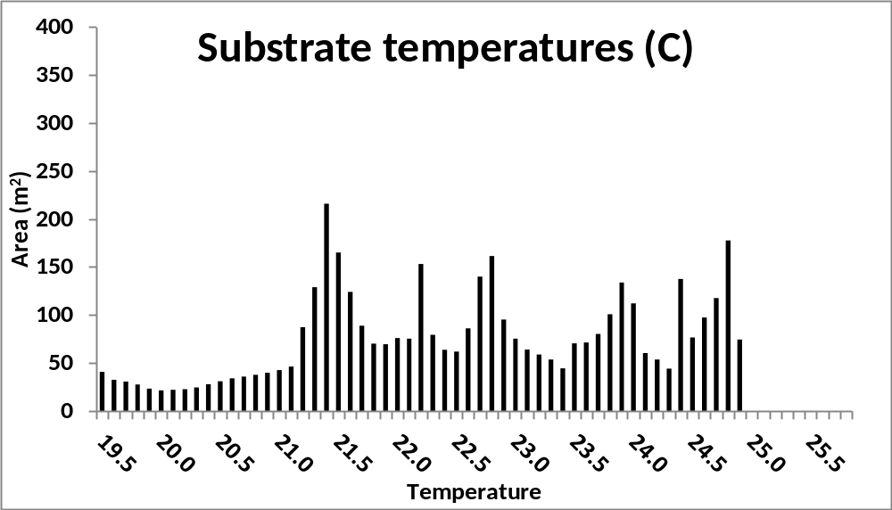
Available
Habitat
(Temps)
Calculated for each 30 minute interval

Slide 19
Preliminary Results

Slide 20
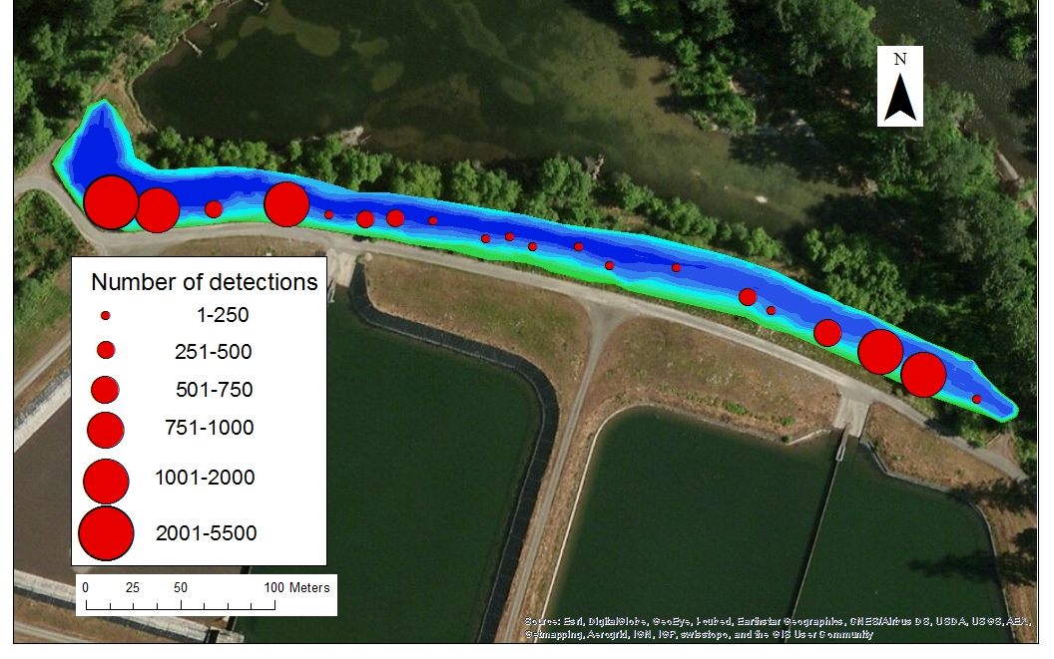
Bluegill Detections

Slide 21
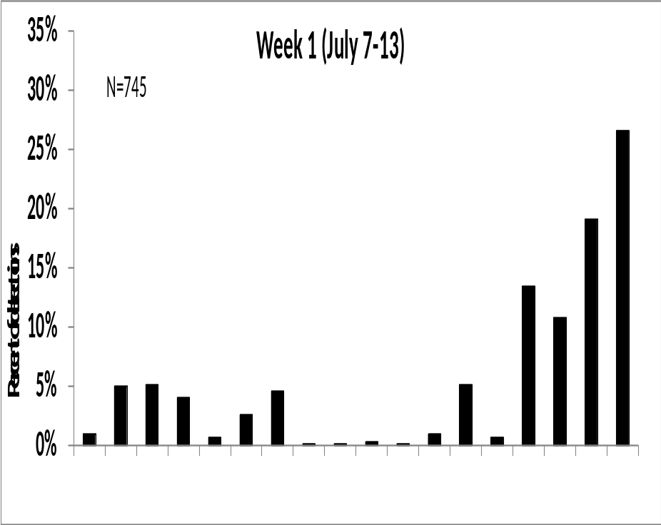
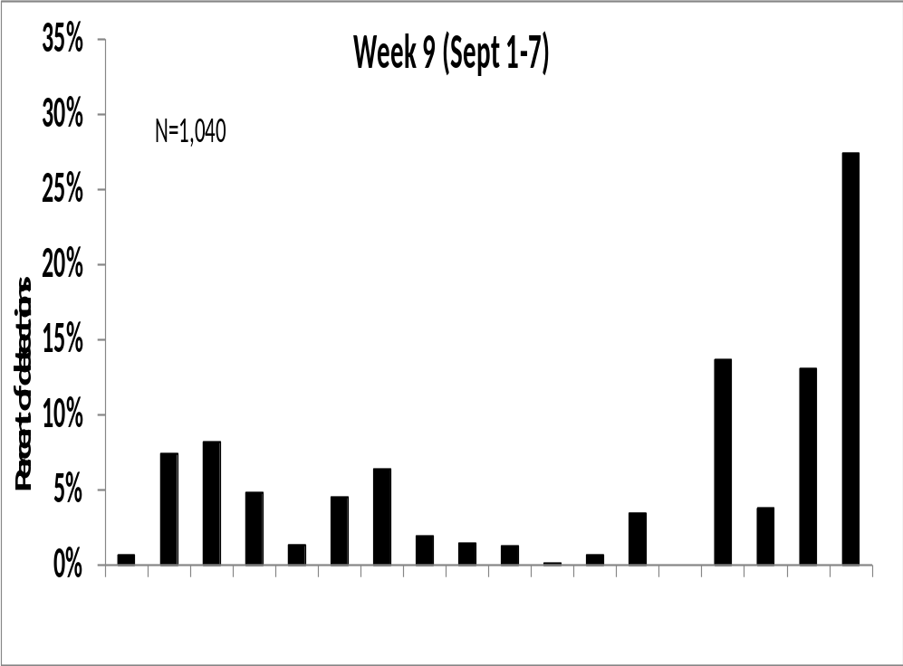
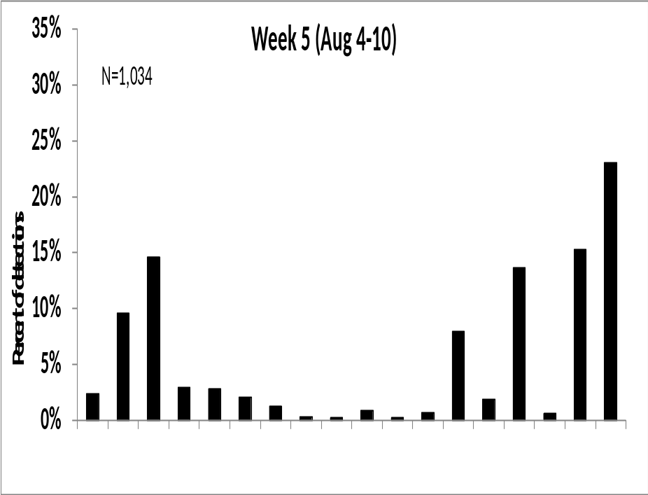
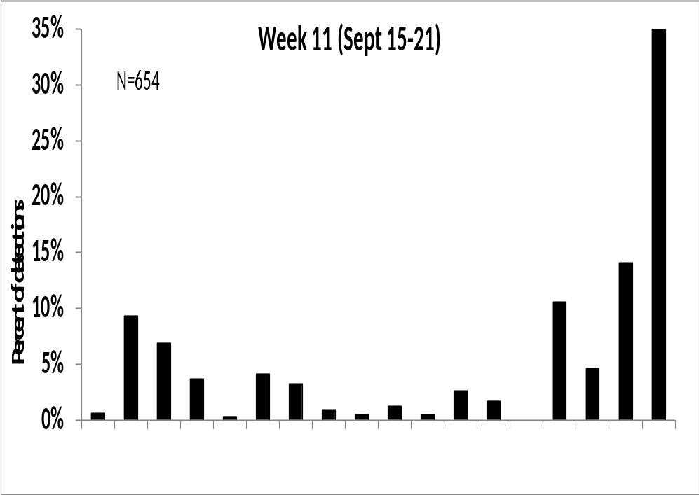
No Changes in Spatial Distribution / Antenna Use over Study
Upstream to downstream
Upstream to downstream

Slide 22
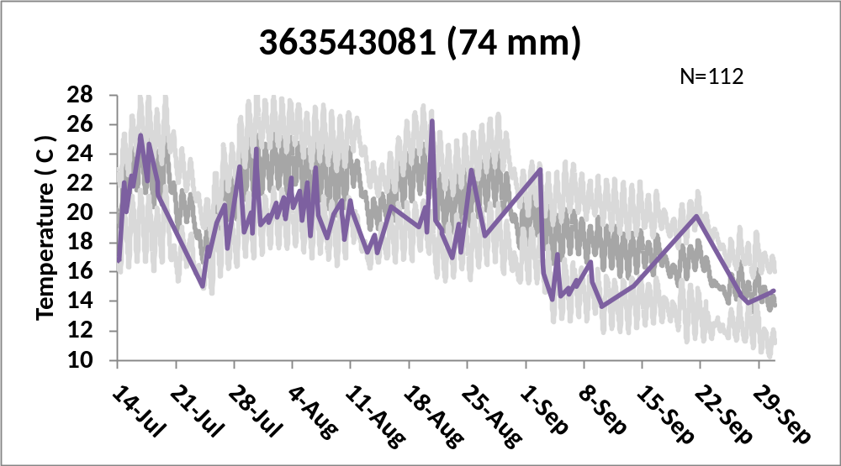
Bluegill Temperature Occupancy vs. Availability
Temperatures=range of daily minimums, maximums, & means for all antennas

Slide 23
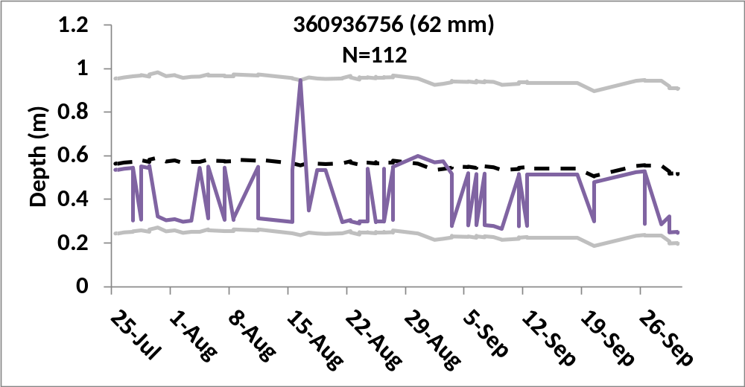
Bluegill Depth Occupancy vs. Availability
Depths= range of daily minimums, maximums, & means for all antennas

Slide 24
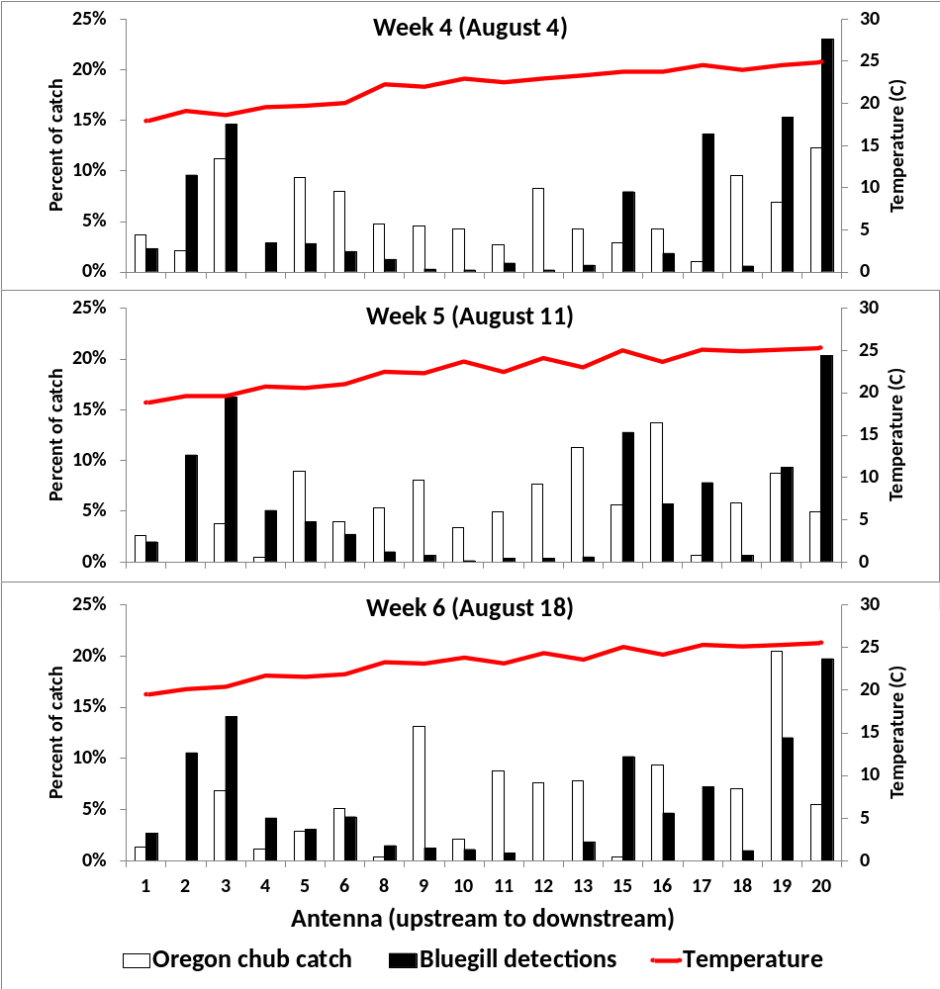
Bluegill & Oregon chub
Bluegill
O. chub
We saw movement of majority of VIE marked chub throughout study area!

Slide 25
Summary
Bluegill did not use all habitats
  No temporal shifts in spatial distribution
Oregon chub used most habitats
Future modelling: include capture histories, temperatures, depths, vegetative cover, edge vs. offshore, bluegill length, time of day
Ultimate goal- tie findings into floodplain study- i.e. what conditions allow natives and nonnatives to coexist (favor natives)?

Slide 26
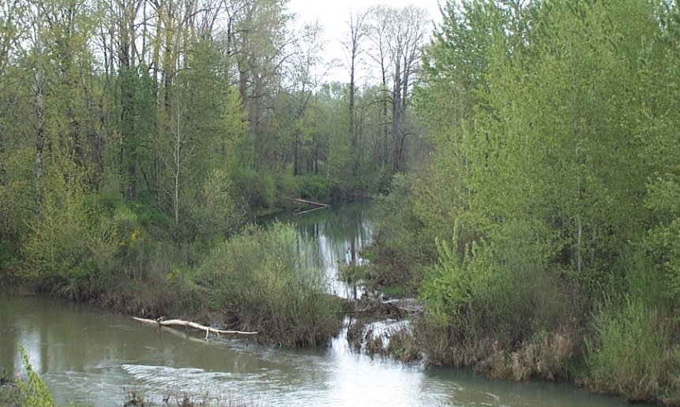
Questions?

